Slide 1
Professional Curriculum Committee Proposal
Jason Nance, Associate Dean for Research and Faculty Development
Levin College of Law
Notes:
General welcome
OUA, part of the office of the Provost, we work with Dr. Lindner

Slide 2
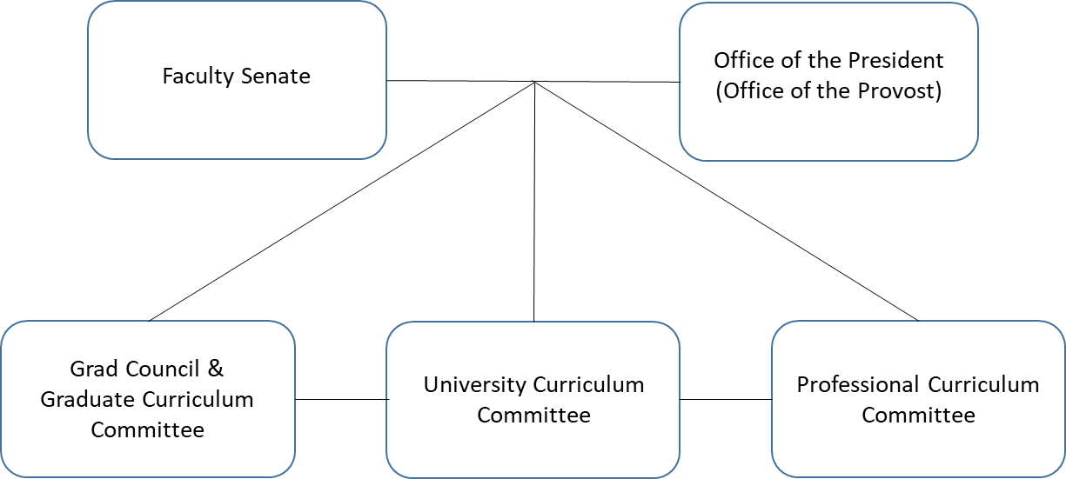
Professional Curriculum Committee
Proposal
Creation of a joint university committee as defined by the UF Constitution
  Staffed by members chosen from the faculty senate and the President’s Office
  Chaired by President appointment or President’s designee appointment
  Co-chaired by senate-appointed committee member selected by senate appointees
Transfer professional curriculum and course oversite from the University Curriculum Committee to the newly established Professional Curriculum Committee
Chairs of Graduate Committees, University Curriculum Committee, and Professional Curriculum Committee communicate regularly to ensure flow of information between committees

Slide 3
Why Create a New Committee for Professional Curriculum?
Rationale
Increasing number of professional programs
Reduce workload on University Curriculum Committee
Ability to review professional curriculum with greater granularity
Address specific needs of professional curriculum development and approval

Slide 4
How Is the Committee Being Created?
Mechanics
March 2021 – July 2021: Workgroup formed by Dr. Angela Lindner, Chair of the University Curriculum Committee to review professional curriculum processes and unique aspects of professional curricula and administrative needs (creation and modification of professional courses, certificates, degree programs)
August 2021 – September 2021: Conversations with General Counsel’s Office and Chair of the Faculty Senate to chart path forward; Formation of sub-working groups for:
  Communications Group – Presenting to sub-committees below
  Constitution Group – Work on wording for UF constitution, regulations, and/or FORA website
  Technical Group – Work with Casey on developing professional-specific curriculum workflows
October 2021 – February 2022: Work with Faculty Senate Chair to begin requesting nominations for membership from the Faculty Senate (provisional pending approval of PCC from full Faculty Senate); present to Faculty Senate sub-committees and University Curriculum Committee to gather feedback for formal request to Faculty Senate:
  Committee on Committees
  Constitution Committee
  Academic Policy Council
  University Curriculum Committee
March 2022: Present to Faculty Senate Steering Committee
April 2022 – May 2022: Present for two votes from the full Faculty Senate

Slide 5
Contact Information
Questions?
Dr. Katie Vogel Anderson, Clinical Associate Professor, College of Pharmacy
kvanderson@cop.ufl.edu
Dr. Jason Nance, Associate Dean for Research and Faculty Development, Levin College of Law
nance@law.ufl.edu
Dr. Karen Whalen, Assistant Dean for Curricular Affairs, College of Pharmacy
  whalen@cop.ufl.edu
Dr. Patricia Pereira, Associate Dean of Academic Affairs, College of Dentistry
ppereira@dental.ufl.edu
Dr. Angela S. Lindner, Associate Provost Undergraduate Affairs
alindner@aa.ufl.edu
Tobin Shorey, Director Curriculum and Policy, Undergraduate Affairs
tshorey@ufl.edu

