Slide 1
SACS Coordinators Meeting Academic Units
Wednesday – January 21, 2015
Timothy Brophy
Director, Institutional Assessment
Cheryl Gater
Director, SACS Accreditation

Slide 2
Today’s Agenda
Academic Assessment Planning and Reporting
Institutional Effectiveness (IE) Documentation
Reporting For 2015-16
Updated Resources
Calendar and Annual Process
Questions and Discussion

Slide 3
AAP Planning and Reporting
What’s New for 2015-16
Program Goals have been added
New Guide for Developing Program Goals and Student Learning Outcomes
Ability to add attachments to the AAP Detail component in Compliance Assist

Slide 4
Updated Resources
Academic Assessment Plans
2015-16 Academic Assessment Planning Guide
2015-16 Academic Assessment Planning PowerPoint
I will take you through the steps now using the guide at http://assessment.aa.ufl.edu/academic-assessment

Slide 5
AAP submission and reporting
Assessment Data Reports |  | Assessment Planning and Development | Academic Assessment Plans
Academic year | Due date |  | Academic year | Due date*
 |  |  | 2013-14 | April 4, 2014
2013-14 | October 10, 2014 | October 11, 2014 – Feb. 26, 2015 | 2015-16 | February 27, 2015
2014-15 | October 9, 2015 | October 9, 2015 – Feb. 25, 2016 | 2016-17 | February 26, 2016
2015-16 | October 14, 2016 | October 14, 2016 – Feb. 24, 2017 | 2017-18 | February 25, 2017
*Plans may be submitted in Compliance Assist! at any time during the planning and development period.
http://assessment.aa.ufl.edu/academic-assessment

Slide 6
Institutional Effectiveness (IE) Overview
No changes planning in from last year
2014-15 plans have been rolled over to 2015-16 in the Compliance Assist

Slide 7
Updated Resources
Institutional Effectiveness
2015-16 IE Planning Documentation Guide
2015-16 IE Planning Documentation PowerPoint
I will take you through the steps now using the guide at http://assessment.aa.ufl.edu/institutional-effectiveness-plans

Slide 8
IE Calendar and Annual Process
Institutional Effectiveness Data Reports |  | Effectiveness Documentation Planning and Development | Effectiveness Documentation Plans
Academic year | Due date |  | Academic year | Due date*
 |  |  | 2014-15 | June 13, 2014
2013-14 | October 10, 2014 | October 11, 2014 – June 11, 2015 | 2015-16 | June 12, 2015
2014-15** | October 9, 2015 | October 9, 2015 – June 9, 2016 | 2016-17 | June 10, 2016
2015-16 | October 14, 2016 | October 14, 2016 – June 8, 2017 | 2017-18 | June 9, 2017
*Plans may be submitted in Compliance Assist! at any time during the planning and development period.
**Starting in 2014-15, All Administrative Units (including colleges) submit data reports.

Slide 9
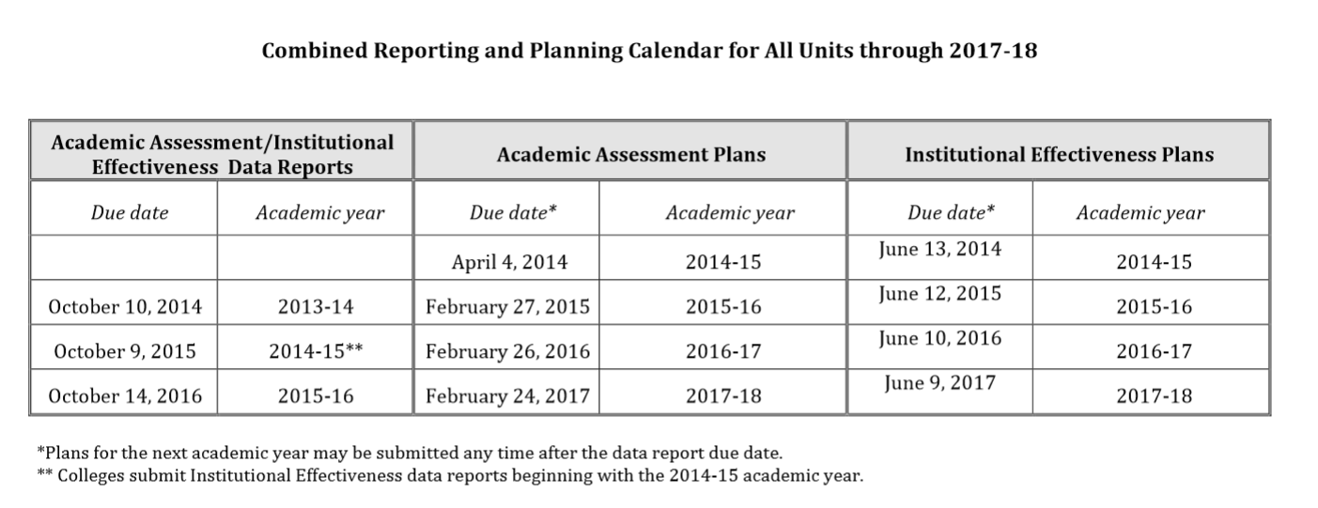
Combined Calendar

Slide 10
Questions?
Thank you!

