Slide 1
UF Compliance Assist!
Cheryl Gater
Director, SACS Accreditation

Slide 2
Access Levels
Reviewer:
Read-only, no editing capabilities
Contributor:
Editing capabilities
Administrator:
Not a site administrator, however, able to modify the “description” of a standard/ requirement for things like internal comments or executive-level comments and allow only administrator-level users to enter content in those areas.

Slide 3
Modules
Planning:
Assessment Plans, Program Goals, and Student Learning Outcomes
Accreditation:
SACS Reaffirmation Components
Faculty Credentials:
For faculty of record for Fall 2012 courses

Slide 4
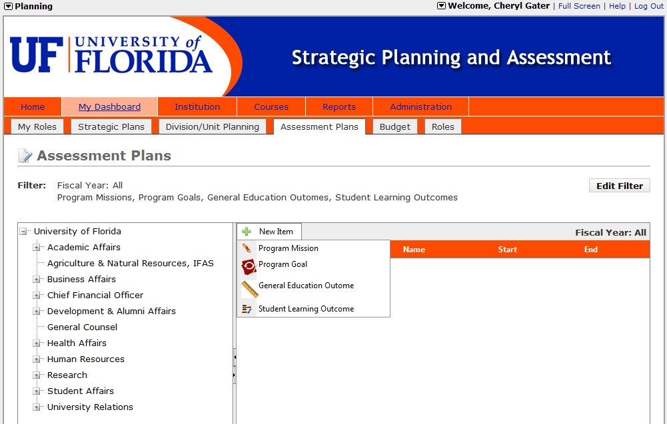
Planning Module

Slide 5
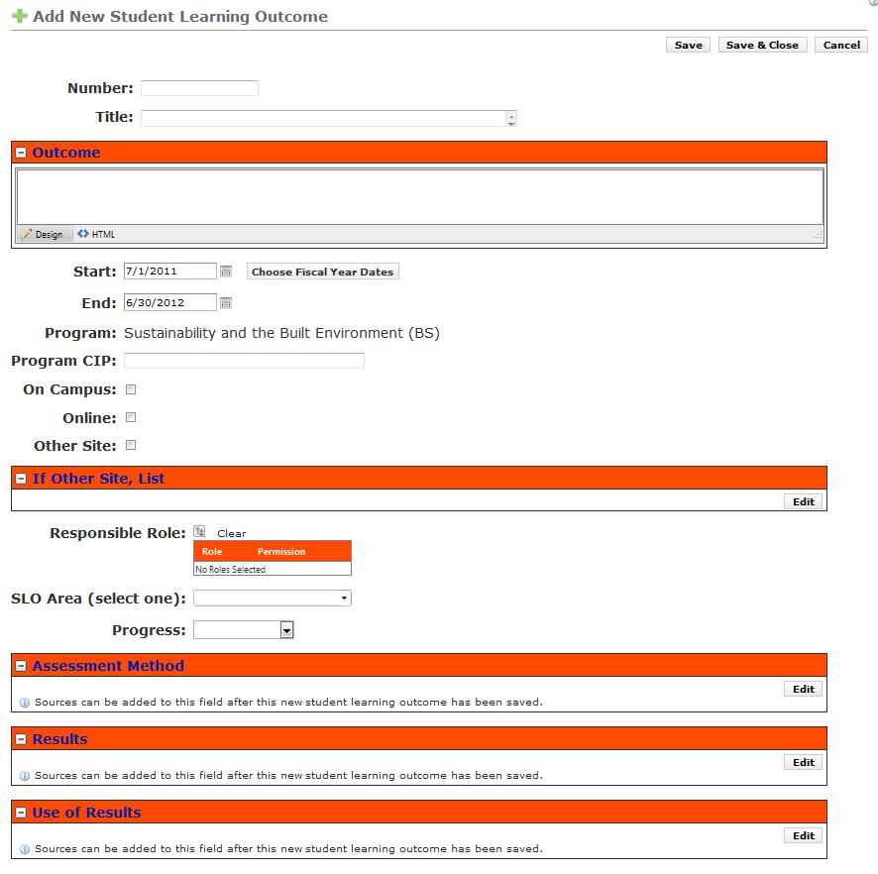
Planning Module

Slide 6
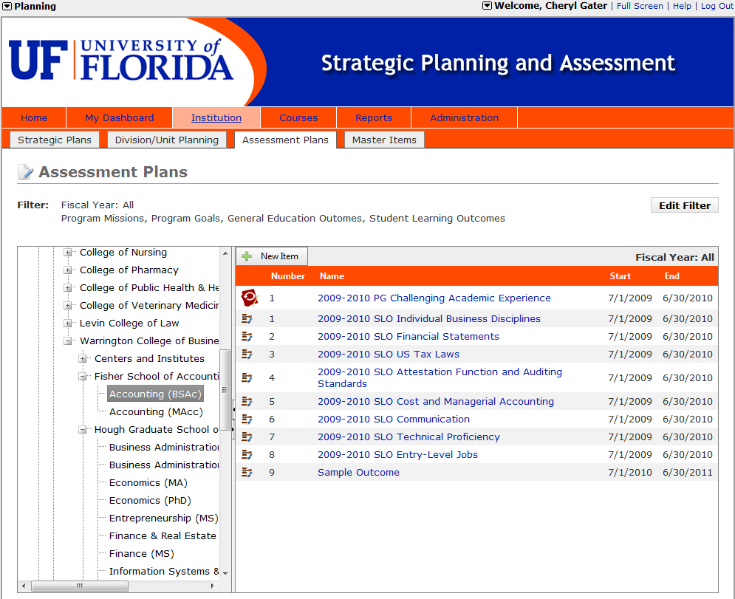
Planning Module

Slide 7
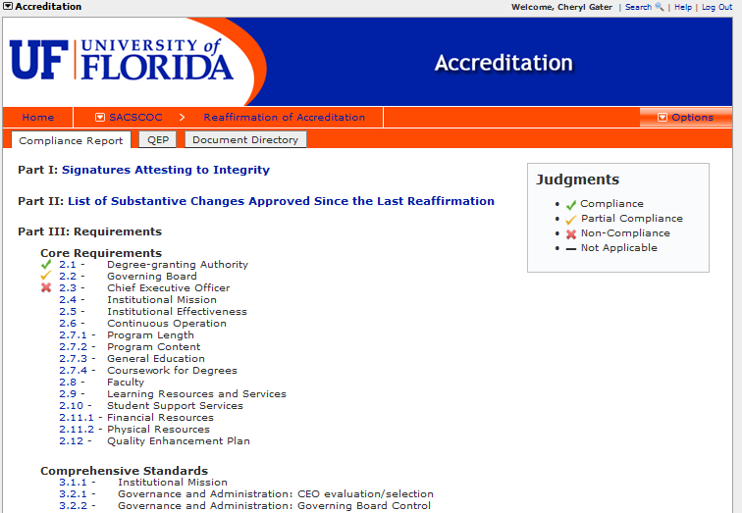
Accreditation Module

Slide 8
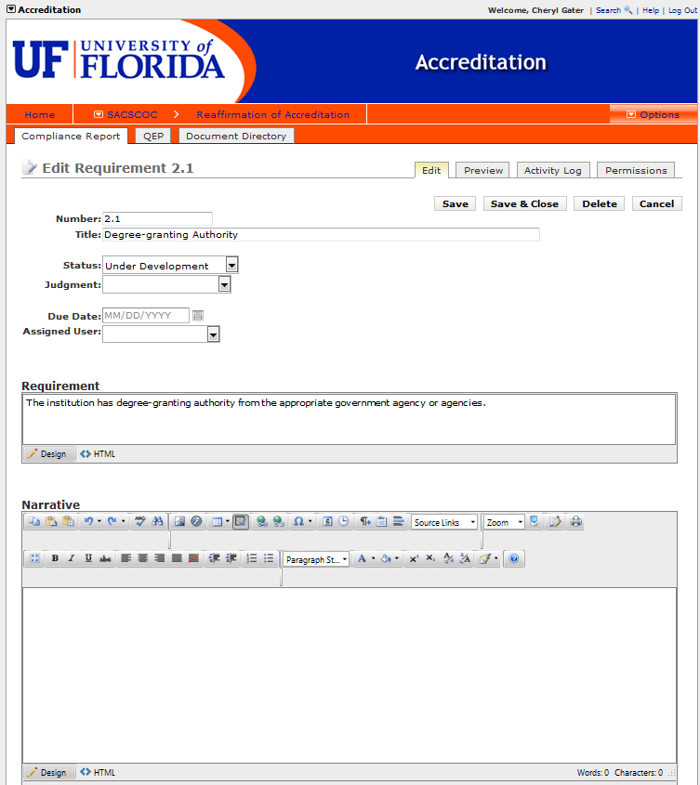
Accreditation Module

Slide 9
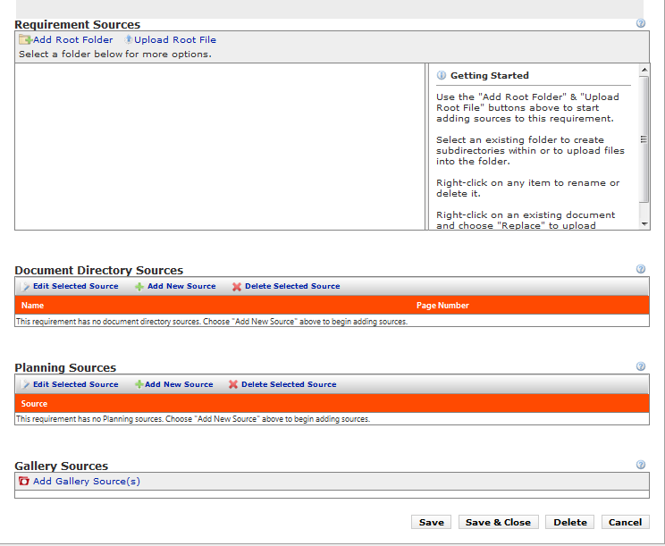
Accreditation Module

Slide 10
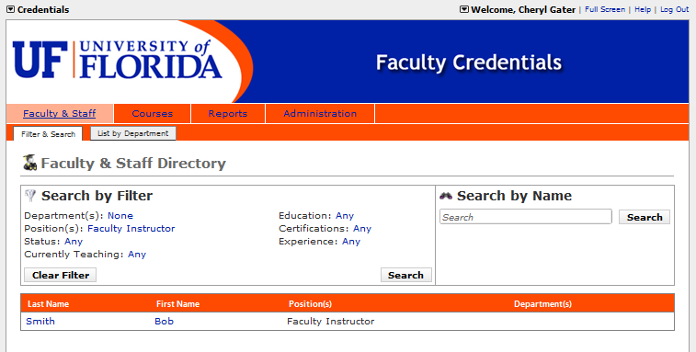
Credentials Module

Slide 11
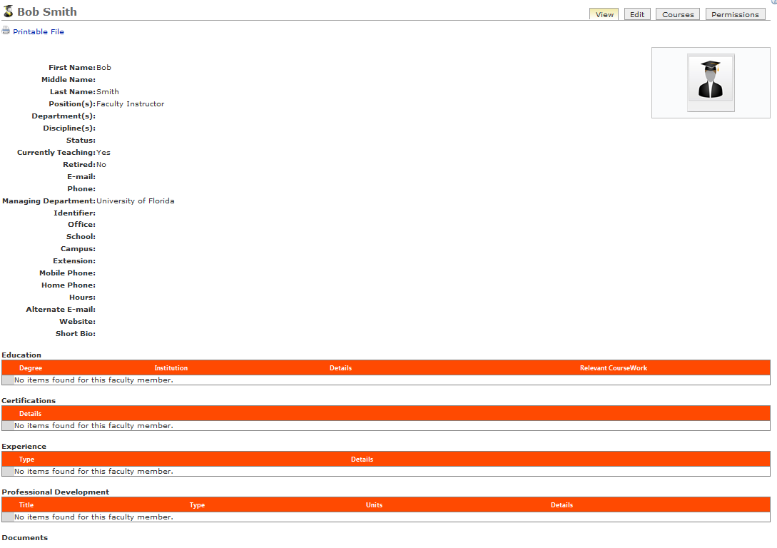
Credentials Module

Slide 12
Follow-up
E-mail Cheryl Gater at cgater@aa.ufl.edu with names of individuals needing access by October 31, 2011.
Register for a Compliance Assist! training session on November 17 or 18. Go to SACS Resources at http://sacs.aa.ufl.edu/resources for the listing of available training times and registration.

