Slide 1
Creating a Culture of Assessment in UF Student Affairs
Dr. Jeanna Mastrodicasa
Assistant Vice President for Student Affairs
jmastro@ufl.edu

Slide 2
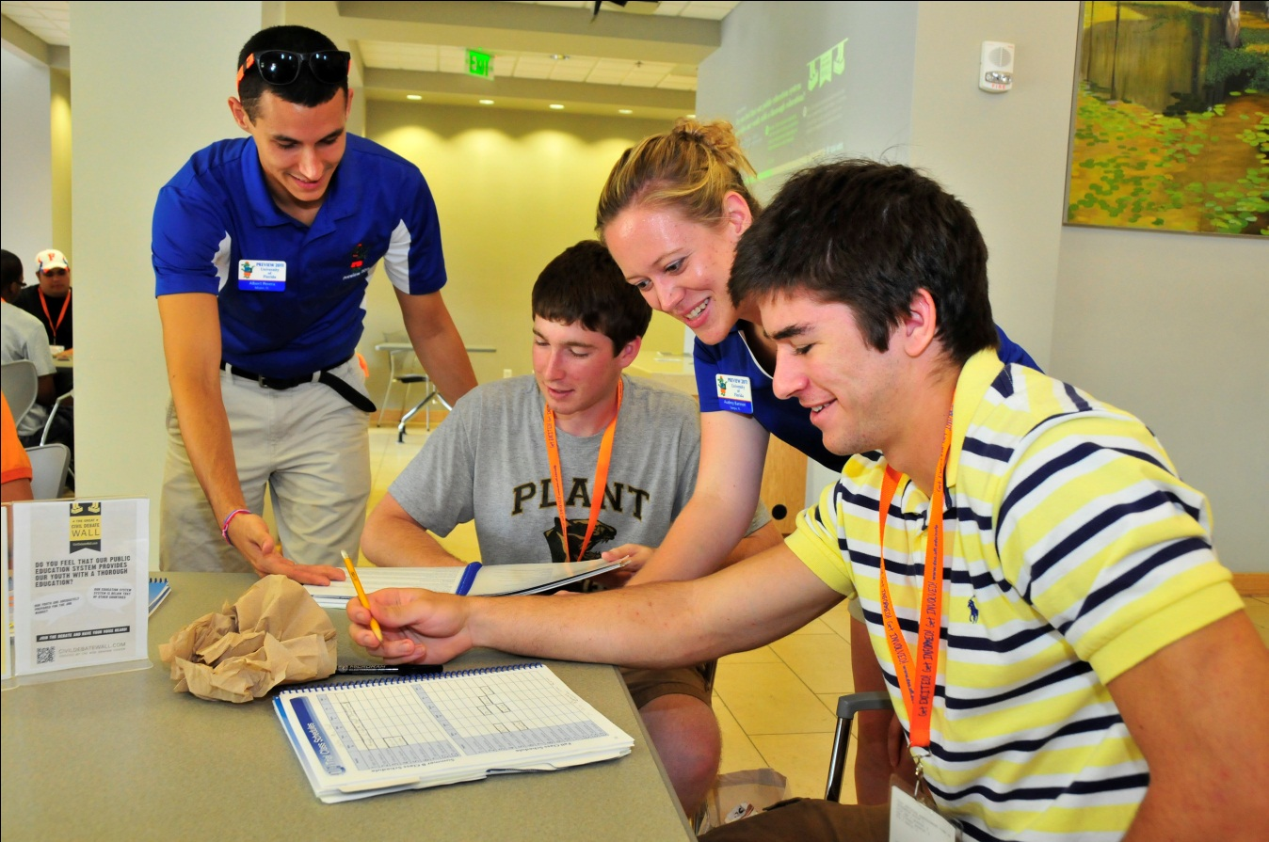
What is Student Affairs?
UF Student Affairs has 13 departments with 600 employees which provide a wide range of services, educational opportunities, learning, support, outreach, activities, and engagement in multiple facilities.

Slide 3
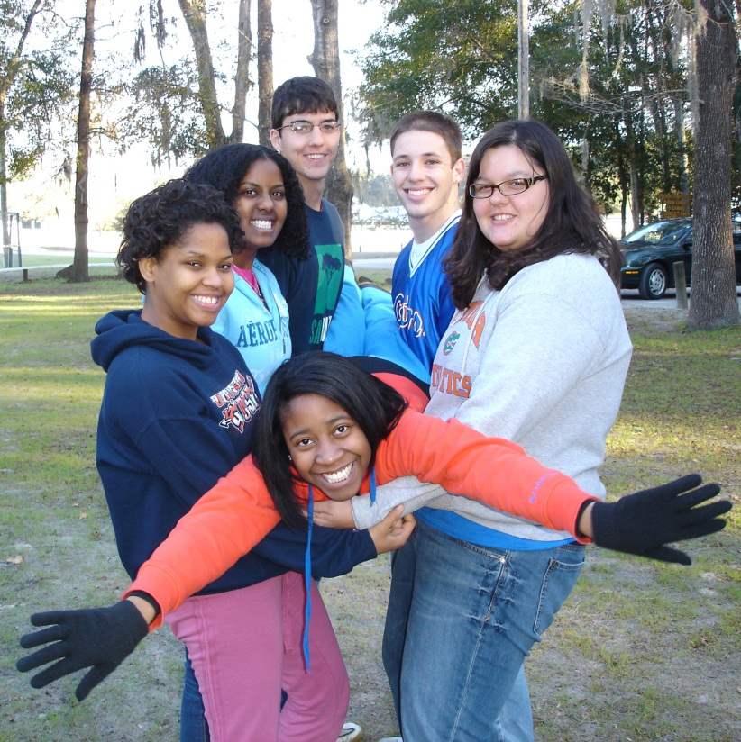
What is Student Affairs?
UF Student Affairs is the lead contact for:
Career counseling and placement
Student organizations including sororities and fraternities
Orientation for new students
Parents and families of students
Student emergencies and deaths
Multicultural and diversity affairs
Counseling and behavioral issues
Student conduct
Healthy behavior, including alcohol policies
Student Government
Student leadership and community service
Housing
Intramurals, fitness, and sport clubs

Slide 4
2012 UF Mission Statement
UF is a public land-grant, sea-grant and space-grant research university and encompasses virtually all academic and professional disciplines. It is a member of the Association of American Universities. Its faculty and staff are dedicated to the common pursuit of the university’s threefold mission: teaching at the undergraduate and graduate levels; research and scholarship integral to the educational process and the expansion of our understanding of the natural world; and service that reflects the university’s obligation to share the benefits of its research and knowledge for the public good. The university serves the nation’s and the state’s critical needs by contributing to a well-qualified and broadly diverse citizenry, leadership, and workforce.

Slide 5
2012 UF Vision Statement
UF aspires to become a top-ten public research university by: enhancing the quality of undergraduate education;
meeting the state’s workforce needs through advanced professional degrees;
attracting the finest student minds in the world for doctoral research and training;
attracting and retaining a world-class faculty to engage students and to pursue vigorous externally funded research programs leading to new discoveries and inventions;
building on UF’s excellent national ranking in technology transfer and licensing to spur new businesses and state economic development;
providing service and outreach to the citizens of Florida.
UF seeks to effectively leverage its resources in a transparent and accountable manner to provide the maximum return on investment to the state.

Slide 6
Student Affairs Strategic Plan
Mission, vision, values, key strategic areas
Updating it for 2012-2017
Annual priority initiatives (2011-2012):
The Reitz Union Renovation and Construction Project: Develop and implement strategy for long-term needs of building
Initiate the “U Matter, We Care” campaign
Complete the strategic planning process for the Division on Diversity, Inclusion, and Campus Climate including accountability measures
Develop and implement a campus-wide exit survey for graduating seniors to collect data about future plans for graduate school and career and salary information
Encourage and support new Greek housing projects including renovations, capital campaigns and new construction.
Implement Collegiate Link, the database used by student organizations and the institution as a clearinghouse for student organization registration and event planning

Slide 7
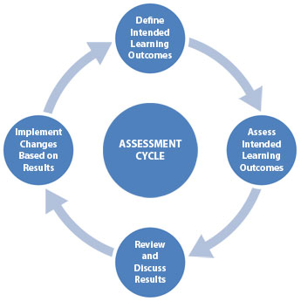
Student Affairs Assessment
The Division will:
Measure the impact of our work in Student Affairs including learning outcomes
Align resource and management decisions based on assessment results
Use research findings to advance the University’s understanding of student issues

Slide 8
History: 2006-2007 UF Student Affairs Assessment Committee
Had one representative from each department plus faculty member from Higher Education department in College of Education.
Essentially wrote a report recommending that Student Affairs should hire an assessment coordinator.

Slide 9
History: 2007-present: UF Student Affairs Assessment Committee
Reworked membership of Assessment Committee and invited all interested individuals to participate and restarted the mission.
Wrote first assessment plan for the division (measure an outcome and report core activities).
First Assessment plans turned in December 2009.
Coordinates assessment training and sharing results
Three subcommittees: projects, training, and reporting

Slide 10
Student Affairs Assessment
What do we measure in student affairs?
Tracking numbers
Some learning outcomes
Satisfaction
Needs
Other initiatives to support work of division, e.g., JWRU expansion
Student Learning Outcomes: theme for 2012

Slide 11
Assessment Training
September 2008: Assessment Boot Camp, all-day training. Invited Dr. Darby Roberts, Texas A&M University, as keynote speaker. Two tracks of training: beginner and intermediate.
May 2009: Assessment Boot Camp, all day training. Invited Kim Vanderlinden from Student Voice as keynote speaker. Three tracks of training: beginner, intermediate, and advanced.
Webinars from Campus Labs

Slide 12
Campus Labs (Student Voice)
Became client of Campus Labs (Baseline) in December 2008.
Allows for unlimited web surveys for student affairs staff—includes mail management, open link, ability to collect data in the field with itouch or ipad
Provides unlimited consultation with assessment experts
Training via webinars

Slide 13
Benchmark Studies
Can participate in several through Campus Labs (2-4 each year)
Includes orientation, student recreation, campus activities, student union, career center, counseling center
Student Experience in Research Universities (SERU) in 2009, 2011: http://www.ir.ufl.edu/OIRApps/SERU/signon.aspx
Further analysis by race, sexual orientation, specific student populations like Florida Opportunity Scholars, intramural sports participants, on-campus residents, sorority and fraternity members

Slide 14
Sharing Results
May 2011: 1st Student Affairs Assessment Symposium; allowed staff to present results of research to others. Dr. Allison Crume from Florida State University was keynote speaker.
May 2012: 2nd Student Affairs Assessment Symposium; included staff from Santa Fe College and College of Central Florida.
Annual assessment reports in each department
Dashboard of data (on Sharepoint)
Future regular publication to campus stakeholders

Slide 15
Student Affairs Assessment
Southern Association of Schools Consortium accreditation visit 2014
Each department will need to turn in the information that SACS requires us to turn in annually (first one due Oct. 2012):
Program Goals/Evaluation Method/Results/Use of Results
Student Learning Outcomes/Assessment Method/Results/Use of Results
Each department will still write a narrative report for one other item of their choice (using the template), due December 2012.

Slide 16
The future
Tying the strategic plan process and departmental goals better to the information and data being reported by departments, and making it all one set of information.
Reviewing the dashboard information and considering changes to the information being reported
Have departments write and measure student learning outcomes throughout the division
Consider writing one set of overall learning outcomes for the division

