Slide 1
SACS Coordinators Meeting
April 25, 2012
Cheryl Gater - Director, SACS Accreditation
Timothy Brophy – Director, Institutional Assessment

Slide 2
Today’s Agenda
1. Communications Plan Discussion
2. Review of Due Dates and Components
3. Update of Online Resources
4. Questions and General Discussion

Slide 3
Communications Plan Discussion
Selected Student Financial Aid Data for UF Undergraduate Students for the Three Most Recent Available Years
 | Academic Year
 | 2007-08 | 2008-09 | 2009-10
All UG Students:
Pell Grants | Not Available | $30,894,352 | $41,996,944
Federal Loans | Not Available | $60,969,318 | $59,795,534
Full-time, First-time degree/certificate-seeking UG students
Federal Grants | $5,822,700 | $6,512,300 | $10,400,395
Pell Grants | $4,278,891 | $5,471,084 | $8,097,580
Other Federal Grants | $1,543,300 | $1,041,216 | $2,302,815
Federal Loans | $5,534,795 | $6,651,786 | $7,457,421
Source: IPEDS Student Financial Aid Component

Slide 4
Communications Plan Discussion
What additional information or communications would be helpful for Institutional Assessment to provide?
Emails to department chairs?
Informational emails to be forwarded onto college LISTSERVs by SACS coordinators?
Other ideas?

Slide 5
Due Dates
2012
May 11
May 18
November 30
December 21
2013
March 15
May 10

Slide 6
May 11, 2012 http://sacs.aa.ufl.edu/core-requirements
General Counsel
CR 2.1 – Degree-granting Authority
CR 2.2 – Governing Board
CR 2.3 – Chief Executive Officer
CS 3.2.1 – CEO Evaluation/Selection

Slide 7
May 11, 2012 http://sacs.aa.ufl.edu/comprehensive-standards
General Counsel
CS 3.2.2 – Governing Board Control
CS 3.2.3 – Board Conflict of Interest
CS 3.2.4 – External Influence
CS 3.2.5 – Board Dismissal
CS 3.2.6 – Board/Administration Distinction

Slide 8
May 11, 2012 http://sacs.aa.ufl.edu/comprehensive-standards
General Counsel
CS 3.2.11 – Control of Intercollegiate Athletics
CS 3.2.13 – Institution-related Entities
CS 3.2.14 – Institutional Property Rights
Research
CS 3.2.14 – Institutional Property Rights

Slide 9
May 11, 2012 http://sacs.aa.ufl.edu/core-requirements
Enrollment Management
CR 2.6 – Continuous Operations
CR 2.7.1 – Program Length
CR 2.7.2 – Program Content
CR 2.7.3 – General Education
CR 2.7.4 – Course Work for Degrees

Slide 10
May 11, 2012 http://sacs.aa.ufl.edu/compliance-certification
Human Resource Services
CS 3.2.9 – Personnel Appointments
CS 3.2.10 – Administrative Staff Evaluations
Libraries
CR 2.9 – Learning Resources and Services

Slide 11
May 11, 2012 http://sacs.aa.ufl.edu/core-requirements
Student Affairs
CR 2.10 – Student Support Services
CFO
CR 2.11.1 – Financial Resources

Slide 12
May 11, 2012 http://sacs.aa.ufl.edu/compliance-certification
Business Affairs
CR 2.11.2 – Physical Resources
CS 3.11.1 – Control of Physical Resources
CS 3.11.2 – Institutional Environment
CS 3.11.3 – Physical Facilities

Slide 13
Review Components and Due Dates
May 18, 2012
All Academic Units
Undergraduate Academic Assessment Plans
November 30, 2012
EVERYONE – Academic Units and VP Units
Institutional Effectiveness Process

Slide 14
December 21, 2012 http://sacs.aa.ufl.edu/comprehensive-standards
Enrollment Management
CS 3.4.3 – Admissions Policies
CS 3.4.4 – Acceptance of Academic Credit
CS 3.4.5 – Academic Policies
CS 3.4.6 – Practices for Awarding Credit
CS 3.4.8 – Noncredit to Credit

Slide 15
December 21, 2012 http://sacs.aa.ufl.edu/comprehensive-standards
Enrollment Management
CS 3.5.2 – Institutional Credits for a Degree
CS 3.5.3 – Undergraduate Program Requirements
CS 3.9.2 – Student Records

Slide 16
December 21, 2012 http://sacs.aa.ufl.edu/comprehensive-standards
Graduate School
CS 3.6.1 – Post-baccalaureate Program Rigor
CS 3.6.2 – Graduate Curriculum
CS 3.6.3 – Institutional Credits for a Graduate Degree
CS 3.6.4 – Post-baccalaureate Program Requirements

Slide 17
December 21, 2012 http://sacs.aa.ufl.edu/comprehensive-standards
Libraries
CS 3.8.1 – Learning/Information Resources
CS 3.8.2 – Instruction of Library Use
CS 3.8.3 – Qualified Staff

Slide 18
December 21, 2012 http://sacs.aa.ufl.edu/comprehensive-standards
Student Affairs
CS 3.9.1 – Student Rights
CS 3.9.2 – Student Records (jointly with EM)
CS 3.9.3 – Qualified Staff (Student Affairs and Services)

Slide 19
March 15, 2013
All Academic Units
Graduate Academic Assessment Plans
Request will be rolled out in early fall 2012
Elements:
Mission
SLOs
Assessment sequence
Description of assessment methods & procedures

Slide 20
May 10, 2013 http://sacs.aa.ufl.edu/comprehensive-standards
All Academic Units
CS 3.7.1 – Faculty Competence
CS 3.7.4 – Academic Freedom
CS 3.7.5 – Faculty Role in Governance
Human Resource Services
CS 3.7.2 – Faculty Evaluation

Slide 21
May 10, 2013 http://sacs.aa.ufl.edu/comprehensive-standards
CFO
CS 3.10.1 – Financial Stability
CS 3.10.2 – Financial Aid Audits (Jointly with EM)
CS 3.10.3 – Control of Finances
CS 3.10.4 – Control of Sponsored Research/External Funds (Jointly with Research)

Slide 22
May 10, 2013 http://sacs.aa.ufl.edu/comprehensive-standards
Research
CS 3.10.4 – Control of Sponsored Research/External Funds (Jointly with CFO)

Slide 23
May 10, 2013 http://sacs.aa.ufl.edu/compliance-certification
Enrollment Management
CS 3.10.2 – Financial Aid Audits (Jointly w/CFO)
FR 4.3 – Publication of Policies
FR 4.5 – Student Complaints (Jointly w/Student Affairs)
FR 4.6 – Recruitment Materials
FR 4.7 – Title IV Program Responsibilities

Slide 24
May 10, 2013 http://sacs.aa.ufl.edu/compliance-certification
Student Affairs
FR 4.5 – Student Complaints (Jointly w/EM)

Slide 25
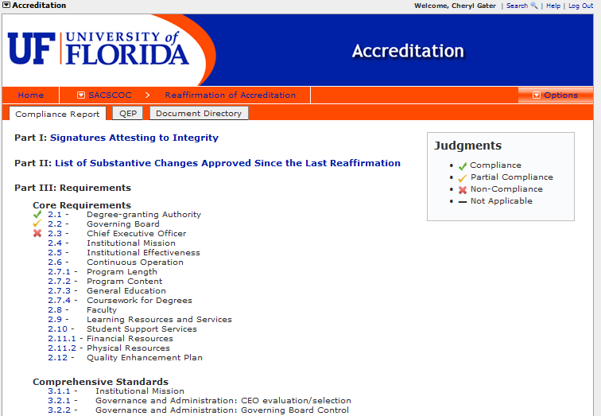
Accreditation Module in Compliance Assist! http://sacs.aa.ufl.edu/compliance-assist-resources Accreditation Module Instruction Guide

Slide 26
Online Resources
http://sacs.aa.ufl.edu/resources
Listing of SACS approved instructional sites
UF Policy on reporting Substantive Changes

Slide 27
Questions and General Discussion
Thank you

